Slide 1
Deploy Auxiliary Micro services to EKS Cluster

Slide 2
WHAT IS EKS?
Amazon Elastic Kubernetes Service (EKS) is a managed service that allows users to run Kubernetes on Amazon Web Services (AWS) without installing or operating their own Kubernetes control plane or worker nodes
WHAT IS KUBERENETES?
Kubernetes is an open-source system that automates the management, scaling, and deployment of containerized applications.
WHAT DOES EKS DO?
EKS automatically manages the availability and scalability of the Kubernetes control plane nodes. It also integrates with AWS networking and security services, such as application load balancers (ALBs), AWS Identity and Access Management (IAM), and AWS Virtual Private Cloud (VPC).

Slide 3
WHAT CAN EKS BE USED FOR?
EKS can be used for a variety of use cases, including:
Deploying and managing web applications
Managing micro services
Deploying and managing machine learning workloads
Running gaming applications
what is Load balancer?
A load balancer is a device or software that distributes incoming network traffic across multiple servers to ensure no single server becomes overwhelmed. It improves the availability, reliability, and performance of applications or services by balancing the load
Common Use Cases:
Web Applications: Ensures that websites or online services can handle large numbers of visitors.
Microservices Architectures: Distributes requests to various microservices running on different servers.
High Availability: Ensures that if one server fails, another can take over, providing uninterrupted service.

Slide 4
Multi-Node Kubernetes Cluster Setup Using Kubeadm
Create an EC2 Instance
Instance Name: Eks-Master, Eks-Agent1, Eks-Agent2
AMI: Ubuntu 24.0
Instance Type: t2.large
Security Group: Enable
HTTP
HTTPS
ALL TCP (0-65535)
Action: Launch the instance
Number of instances: 3
The below commands are run Eks-Master, Eks-Agent1, Eks-Agent2 instances
And some commands are run only on Eks-Master (already mentioned below).

Slide 5
# Update the package list
sudo apt-get update
#install necessary dependencies
sudo apt install apt-transport-https curl –y
#creates the new directory
sudo mkdir -p /etc/apt/keyrings
#downloads Docker's GPG key from the Docker repository
curl -fsSL https://download.docker.com/linux/ubuntu/gpg | sudo gpg --dearmor -o /etc/apt/keyrings/docker.gpg
#Add the Docker repository to your APT sources
echo "deb [arch=$(dpkg --print-architecture) signed-by=/etc/apt/keyrings/docker.gpg] https://download.docker.com/linux/ubuntu $(lsb_release -cs) stable" | sudo tee /etc/apt/sources.list.d/docker.list > /dev/null
#Update APT package index
sudo apt-get update
#Install containerd.io package
sudo apt-get install containerd.io -y

Slide 6
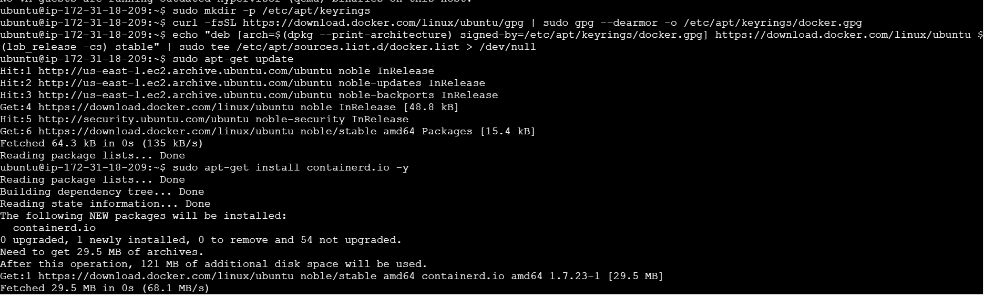

Slide 7
#Create containerd configuration
sudo mkdir -p /etc/containerd
sudo containerd config default | sudo tee /etc/containerd/config.toml
#Edit the containerd configuration file to set SystemdCgroup to true
sudo sed -i -e 's/SystemdCgroup = false/SystemdCgroup = true/g' /etc/containerd/config.toml
#Restart containerd
sudo systemctl restart containerd
#Install Kubernetes
curl -fsSL https://pkgs.k8s.io/core:/stable:/v1.30/deb/Release.key | sudo gpg --dearmor -o /etc/apt/keyrings/kubernetes-apt-keyring.gpg
echo 'deb [signed-by=/etc/apt/keyrings/kubernetes-apt-keyring.gpg] https://pkgs.k8s.io/core:/stable:/v1.30/deb/ /' | sudo tee /etc/apt/sources.list.d/kubernetes.list
sudo apt-get update
sudo apt-get install -y kubelet kubeadm kubectl
sudo apt-mark hold kubelet kubeadm kubectl
sudo systemctl enable --now kubelet

Slide 8
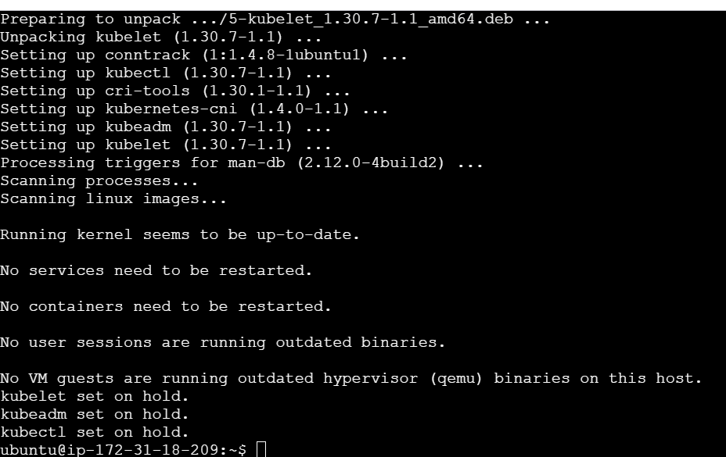
#Disable swap
sudo swapoff –a
#any swap entries in the /etc/fstab file, remove them using a text editor such as nano
sudo nano /etc/fstab
#Enable kernel modules
sudo modprobe br_netfilter

Slide 9
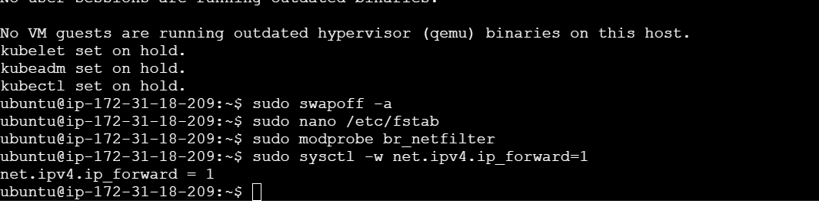
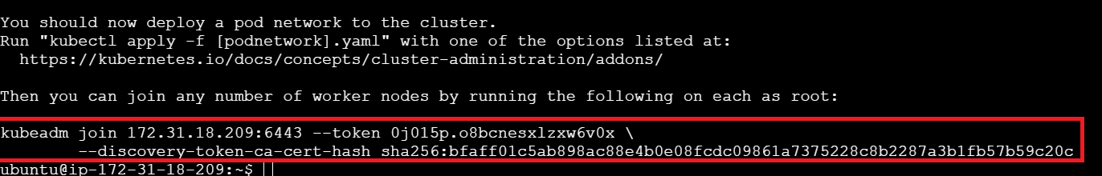
#Add some settings to sysctl
sudo sysctl -w net.ipv4.ip_forward=1
Initialize the Cluster (Run only on Eks-Master instance)
#initialize the cluster
sudo kubeadm init --pod-network-cidr=10.244.0.0/16
After running the above command we’ll get a token copy that and paste it in notepad

Slide 10
#Create a .kube directory
mkdir -p $HOME/.kube
#Copy the Kubernetes configuration file
sudo cp -i /etc/kubernetes/admin.conf $HOME/.kube/config
#Change ownership of the file
sudo chown $(id -u):$(id -g) $HOME/.kube/config
#install Flannel
kubectl apply -f https://github.com/flannel-io/flannel/releases/latest/download/kube-flannel.yml
#Verify that all the pods are up and running
kubectl get pods --all-namespaces

Slide 11
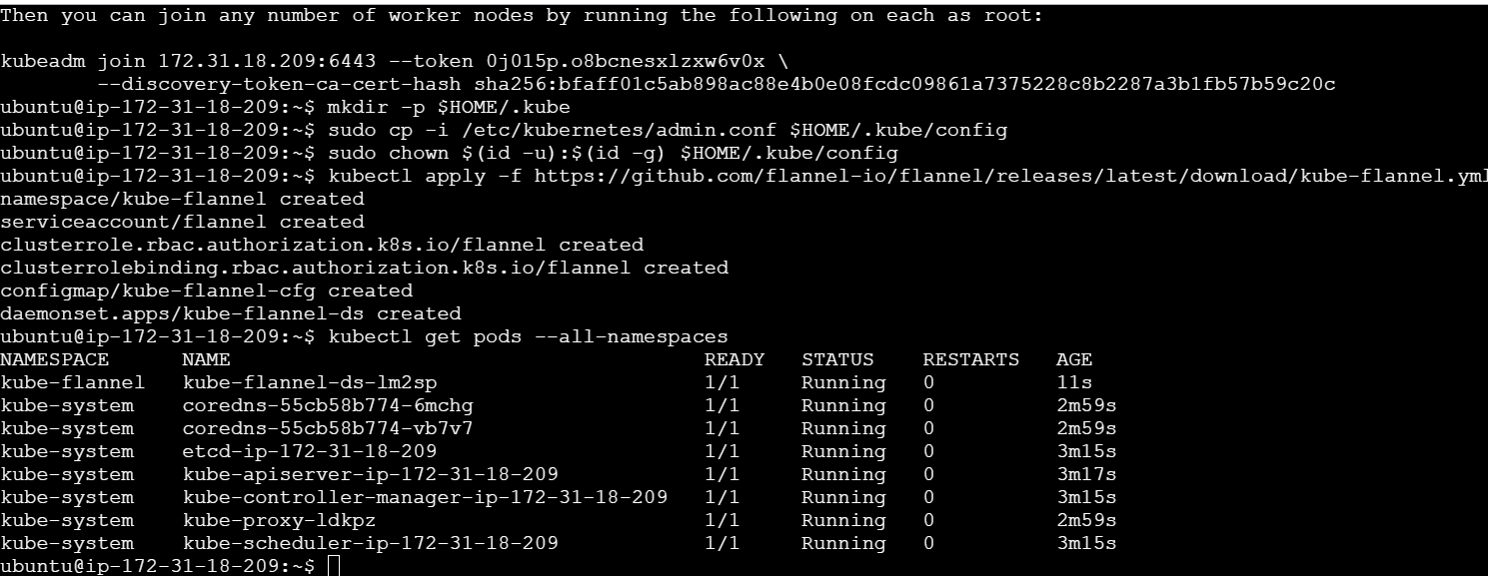

Slide 12
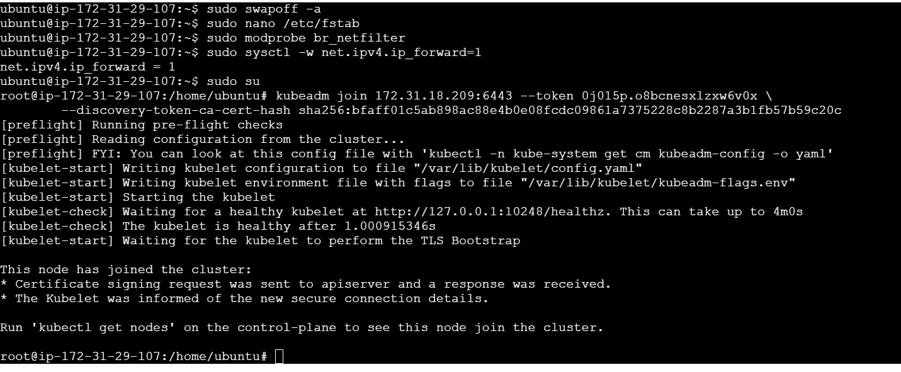
In Eks-Agent1 & Eks-Agent2 instance
#Change to root user
sudo su
In above process we’ll get a kubeadm token, copy that token and paste it in Eks-Agent1, Eks-Agent2 instances.
Then see the output below as “This node has joined the cluster”

Slide 13
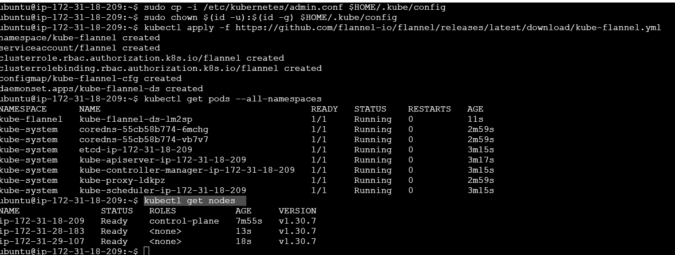
In Eks-Master instance give a command shown in below
# list all the nodes in your Kubernetes cluster
kubectl get nodes

Slide 14

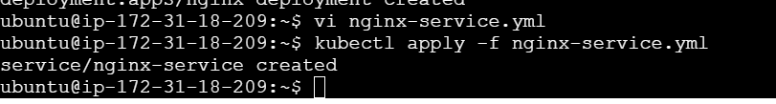
Here, create one nginx-deployment.yml file using below command
vi nginx-deployment.yml
# Apply the NGINX Deployment
kubectl apply -f nginx-deployment.yml
Create one nginx-service.yml file
vi nginx-service.yml
# Apply the NGINX Service
kubectl apply -f nginx-service.yml

Slide 15
vi nginx-deployment.yml
apiVersion: apps/v1 kind: Deployment metadata: name: nginx-deployment labels: app: nginx spec: replicas: 6 selector: matchLabels: app: nginx template: metadata: labels: app: nginx spec: containers: - name: nginx image: nginx ports: - containerPort: 80
Vi nginx-service.yml
apiVersion: v1 kind: Service metadata: name: nginx-service labels: app: nginx spec: selector: app: nginx ports: - protocol: TCP port: 80 targetPort: 80 nodePort: 30007 type: NodePort

Slide 16
#Update the APT package index
sudo apt update
# Install unzip and curl
sudo apt install unzip curl -y
#Download the AWS CLI v2 installer
curl "https://awscli.amazonaws.com/awscli-exe-linux-x86_64.zip" -o "awscliv2.zip"
#Extract the .zip file
unzip awscliv2.zip
#Install AWS CLI
sudo ./aws/install
#Verify AWS CLI Installation
aws --version
#Configure AWS CLI
aws configure

Slide 17
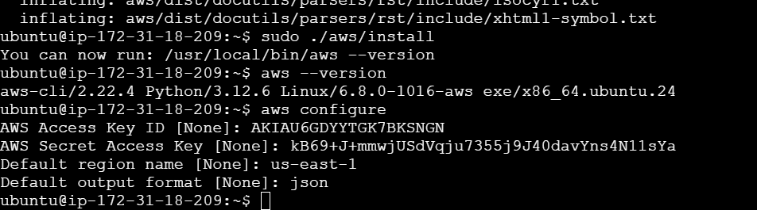
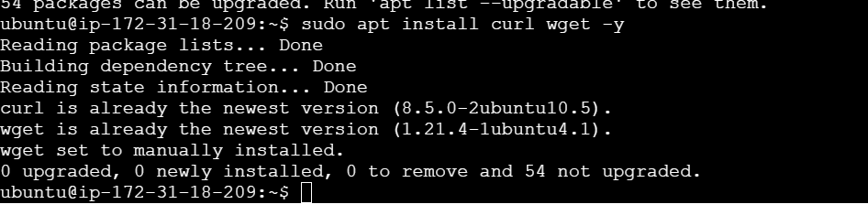
In Aws configure we have to give Access key, Secret key, region and output format
#Update the APT package index again
sudo apt update
#install curl and wget
sudo apt install curl wget -y

Slide 18
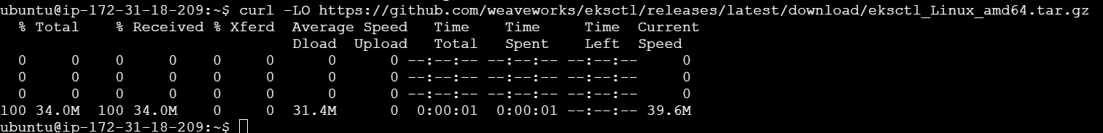

#Download the latest version of eksctl
curl -LO https://github.com/weaveworks/eksctl/releases/latest/download/eksctl_Linux_amd64.tar.gz
#Check the type of file
file eksctl_Linux_amd64.tar.gz
#Extract the .tar.gz archive
tar -xvzf eksctl_Linux_amd64.tar.gz
# Move the eksctl
sudo mv eksctl /usr/local/bin
# Verify eksctl installation
eksctl version

Slide 19
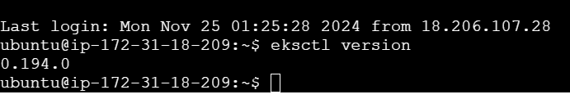
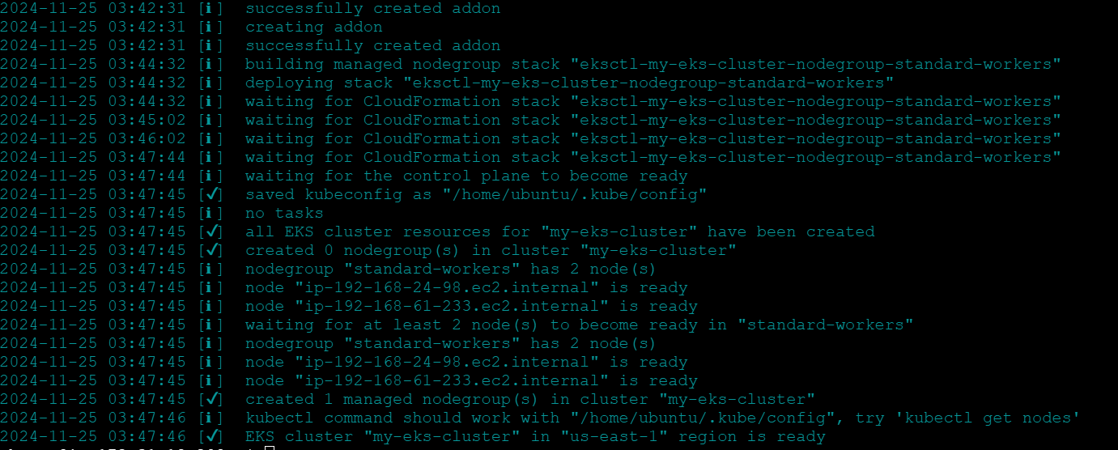
You should see something like
#Create an EKS Cluster
eksctl create cluster --name my-eks-cluster --region us-east-1 --nodegroup-name standard-workers --node-type t2.large --nodes 2
This will create a new EKS cluster in the specified region with 2 nodes of the specified instance type.

Slide 20
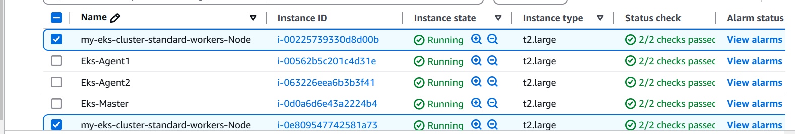
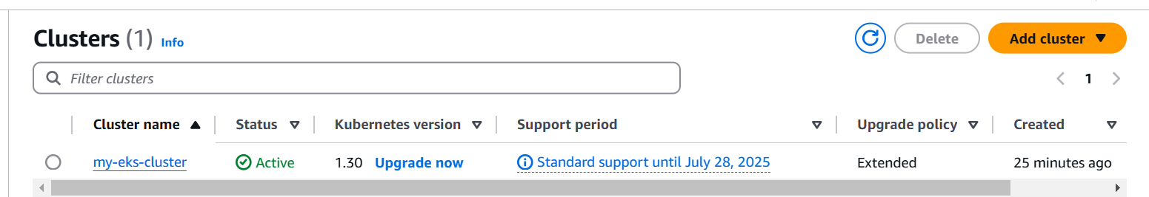
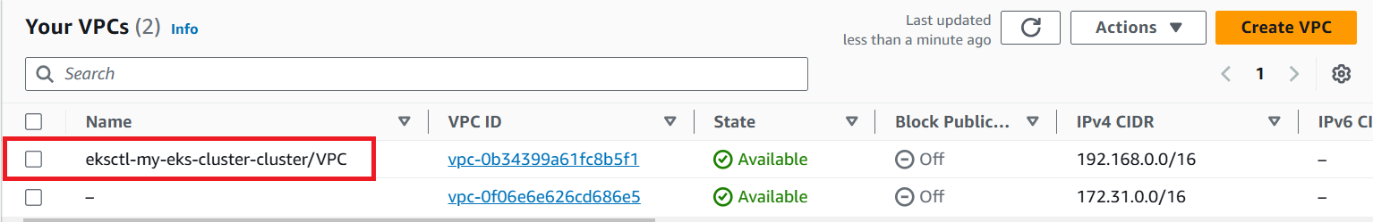

Slide 21
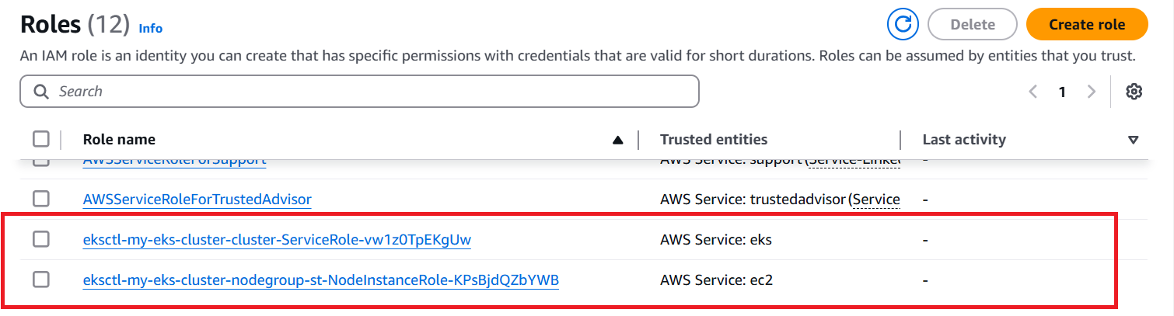

Slide 22
Deploy a web app and store data
Configure the cluster
Create a cluster-config.yaml file and paste the following contents into it. Replace region-code with a valid Region, such as us-east-1
#cluster-config.yaml
apiVersion: eksctl.io/v1alpha5
kind: ClusterConfig
metadata:
name: web-quickstart
region: us-east-1
managedNodeGroups:
- name: eks-mng
instanceType: t2.large
desiredCapacity: 2

Slide 23
iam:
withOIDC: true
serviceAccounts:
- metadata:
name: aws-load-balancer-controller
namespace: kube-system
wellKnownPolicies:
awsLoadBalancerController: true
addons:
- name: aws-ebs-csi-driver
wellKnownPolicies:
ebsCSIController: true
cloudWatch:
clusterLogging:
enableTypes: ["*"]
logRetentionInDays: 30

Slide 24
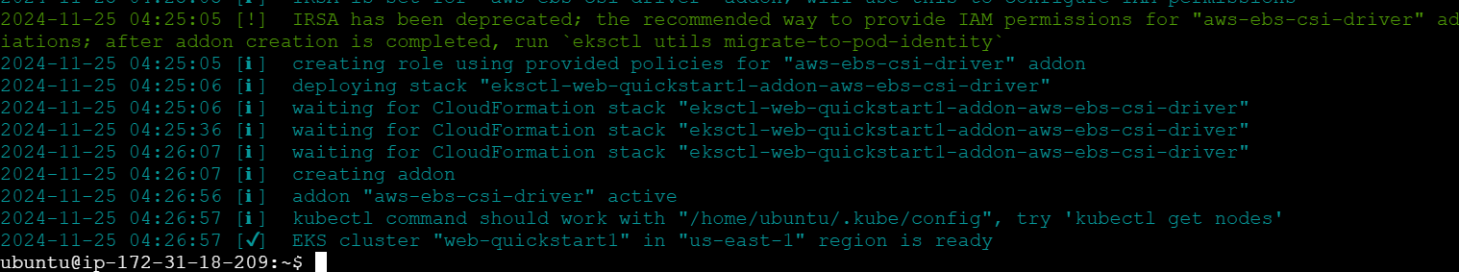
#Create the cluster
eksctl create cluster -f cluster-config.yaml
Now, we’re ready to create our Amazon EKS cluster. This process takes several minutes to complete
Upon completion, you should see the following response output:

Slide 25
Set up external access to applications using the AWS Load Balancer Controller (LBC)
Load Balancer Controller: The AWS Load Balancer Controller is a Kubernetes controller that manages and configures Elastic Load Balancers (ELBs) for a Kubernetes cluster.
To configure environment variables
#Set the CLUSTER_REGION environment variable for your Amazon EKS cluster. Replace the sample value for region-code
export CLUSTER_REGION=region-code
#Set the CLUSTER_VPC environment variable for your Amazon EKS clusterexport
CLUSTER_VPC=$(aws eks describe-cluster --name web-quickstart --region $CLUSTER_REGION --query "cluster.resourcesVpcConfig.vpcId" --output text)

Slide 26
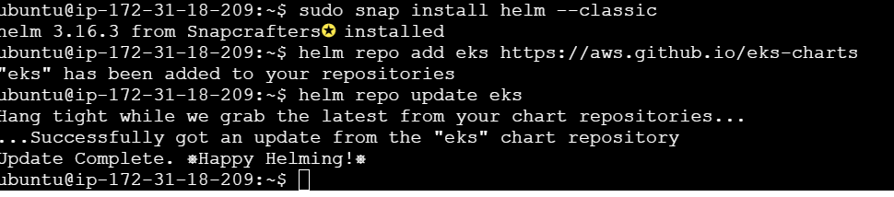
To install the AWS Load Balancer Controller (LBC)
#To install Helm using snap on a Linux system
sudo snap install helm --classic
#Use Helm to add the Amazon EKS chart repository to Helm
helm repo add eks https://aws.github.io/eks-charts
# Update the repositories to ensure Helm is aware of the latest versions of the charts
helm repo update eks

Slide 27
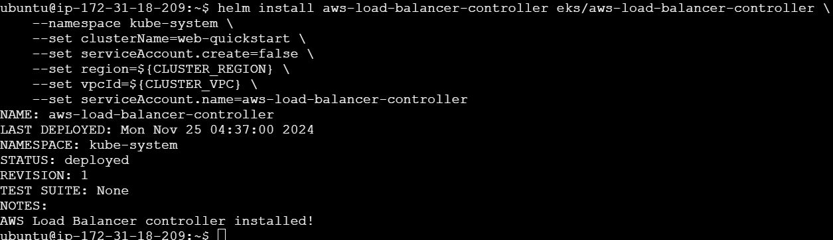
#Run the following Helm command to simultaneously install the Custom Resource Definitions (CRDs) and the main controller for the AWS Load Balancer Controller (AWS LBC).
helm install aws-load-balancer-controller eks/aws-load-balancer-controller \
--namespace kube-system \
--set clusterName=web-quickstart \
--set serviceAccount.create=false \
--set region=${CLUSTER_REGION} \
--set vpcId=${CLUSTER_VPC} \
--set serviceAccount.name=aws-load-balancer-controller
You should see the following response output:

Slide 28
Deploy the 2048 game sample application
#Create a Kubernetes namespace called game-2048 with the --save-config flag.
kubectl create namespace game-2048 --save-config
You should see the following response output:
#Deploy the 2048 Game Sample application
kubectl apply -n game-2048 -f https://raw.githubusercontent.com/kubernetes-sigs/aws-load-balancer-controller/v2.8.0/docs/examples/2048/2048_full.yaml
You should see the following response output:

Slide 29
#Run the following command to get the Ingress resource for the game-2048 namespace.
kubectl get ingress -n game-2048
#Open a web browser and enter the ADDRESS from the previous step to access the web application.
Ex: k8s-game2048-ingress2-eb379a0f83-378466616.region-code.elb.amazonaws.com
You should see the 2048 game in your browser. Play!

Slide 30
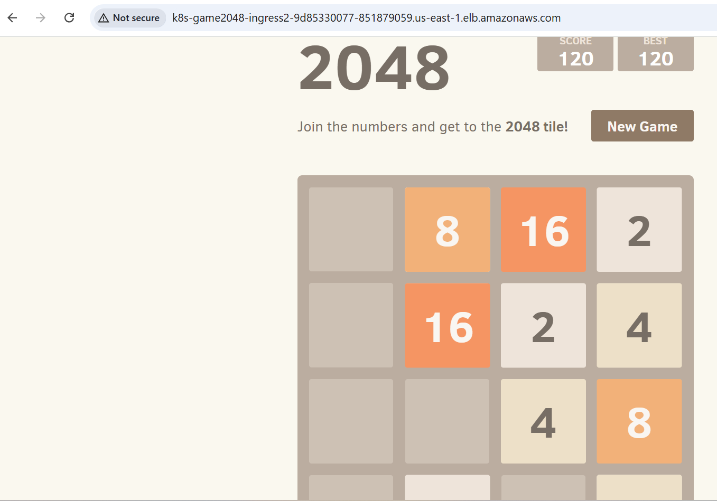

Slide 31
Thankyou

